Slide 1






Lecture 37:
API Optimization
Course - Web Development - II
-By
Instructor Name
welcome@krmangalam.edu.in
Sohna Road,Gurugram,Haryana 122103

Slide 2

| Table of Contents
Debouncing API Calls.
Pagination and Infinite Scroll.
References.
The End.

Slide 3

|
When you’re typing in a search bar and you haven’t finished typing the word, should Google start searching after every single letter, or wait until you pause for a moment?

Slide 4

|
When you’re typing in a search bar and you haven’t finished typing the word, should Google start searching after every single letter, or wait until you pause for a moment?
It should wait until you pause for a moment. If Google searched after every letter, it would waste resources and overload the system. Instead, it waits until you stop typing briefly before making the request.
This is exactly what debouncing does in programming — it ensures the action (like an API call) only happens after the user has paused typing, not on every keystroke.

Slide 5
| Debouncing API Calls
Debouncing means delaying a function execution until after a certain time has passed since the last time it was called.
When a user types in a search bar, you don’t want to call the API for every keystroke — that would waste bandwidth and overload the server.
Instead, you wait until the user stops typing for a moment (say 500ms) and then make one API call.

Slide 6
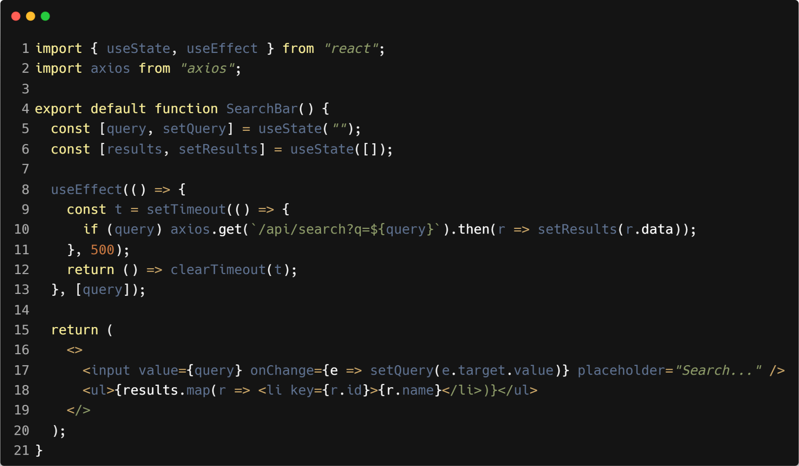
| Debouncing API Calls

Slide 7
| Key Terms in Debouncing
Delay (500ms in our code)
The “wait time” before running the API call.
Example: Google waits 0.5s after you stop typing.
setTimeout
Starts a timer for the API call.
If you keep typing before 500ms, this timer never finishes.
clearTimeout
Cancels the old timer whenever you press a new key.
Ensures only the latest typing attempt matters.

Slide 8
| Key Terms in Debouncing
4. Trigger (query)
The input value (query) is the condition.
Every time it changes, a new debounce cycle starts.
5. Final Action (axios.get)
The real API call.
Runs only after typing pauses for 500ms.

Slide 9

|
When you read a book with 500 pages, do you try to see all the pages at once, or do you flip through one page at a time?

Slide 10

|
When you read a book with 500 pages, do you try to see all the pages at once, or do you flip through one page at a time?
You flip through one page at a time. If you tried to see all 500 pages at once, it would be overwhelming and impossible to handle.
This is exactly how pagination works in programming — instead of loading everything at once, data is divided into manageable chunks (pages) so you can load and view them step by step.

Slide 11
| Pagination
Breaking large amounts of data into smaller, manageable chunks (pages) instead of loading everything at once.
Why?
Improves performance (less data loaded at a time).
Saves bandwidth.
Makes it easier for users to navigate.

Slide 12
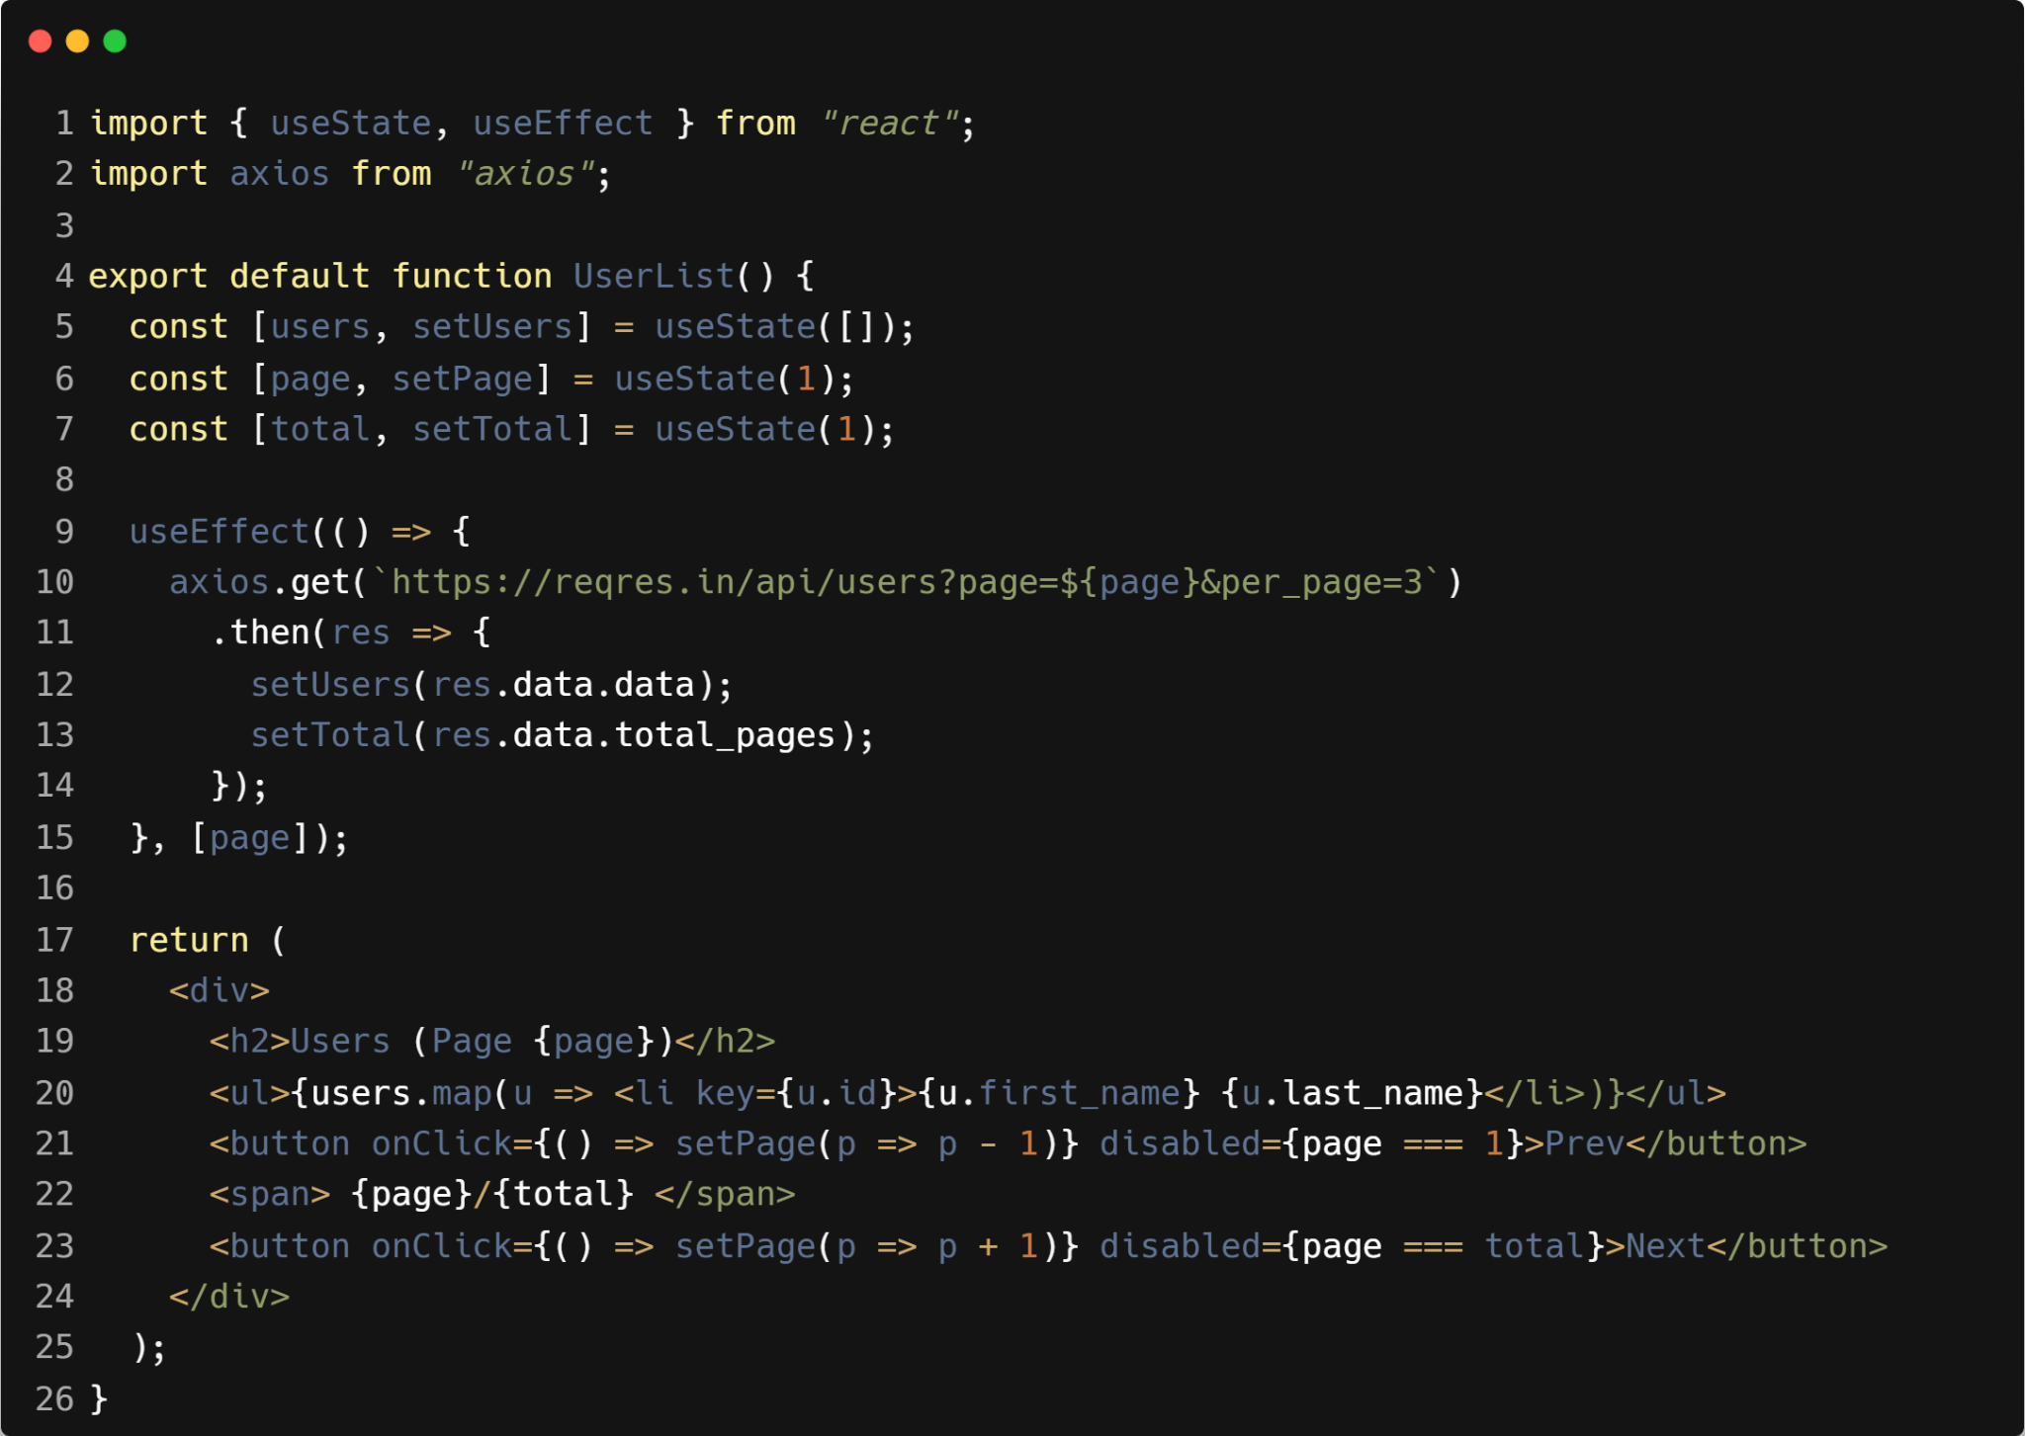
| Pagination

Slide 13

|
When you use Instagram or Youtube, do you ever click Next Page, or does new content just keep appearing as you scroll?

Slide 14

|
When you use Instagram or Youtube, do you ever click Next Page, or does new content just keep appearing as you scroll?
You never click Next Page — new content just keeps loading automatically as you scroll down.
That’s exactly how infinite scroll works in programming — instead of manually switching pages (pagination), the app keeps fetching and adding more data seamlessly as you keep scrolling.

Slide 15
| Infinite Scroll
A technique where new data automatically loads as the user scrolls down, instead of requiring them to click “Next Page.”
Common in apps like Instagram, Facebook,Youtube and TikTok.
Why use Infinite Scroll?
Seamless Experience – Users don’t have to click “Next Page”; content flows
naturally.
Engagement Boost – Keeps users scrolling longer (like Instagram/TikTok).
Best for Feeds – Works perfectly when content is endless (social media, news,
products).
Mobile-Friendly – Easy for users on phones (less clicking, more swiping).

Slide 16
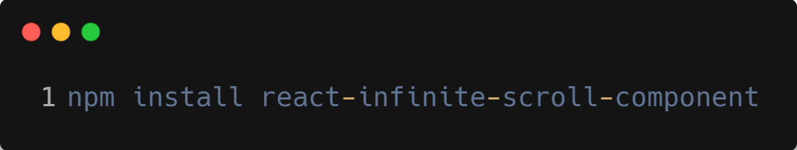
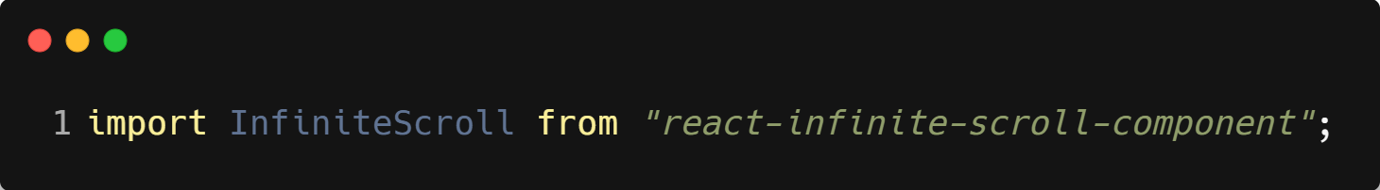
| react-infinite-scroll-component
It’s a ready-made React library that helps us easily add infinite scrolling to our app, so more data loads when the user scrolls down.
Steps To Use :
Install It
Import And Use

Slide 17
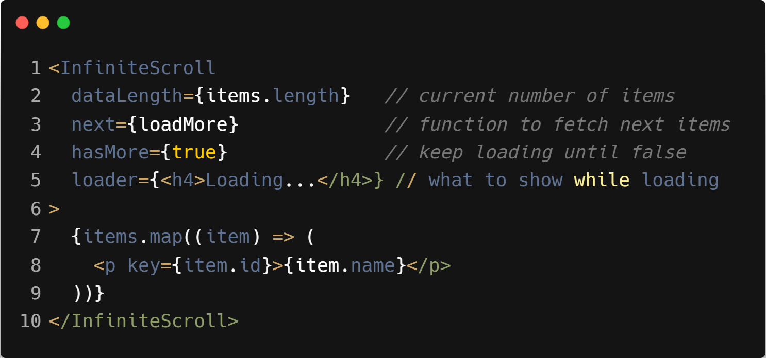
| react-infinite-scroll-component
3. Wrap Your List

Slide 18

| Check Your Understanding
Question : What is "debouncing" in the context of API calls?
Options : a) Making an API call bounce between two servers for reliability.
b) A technique to group multiple sequential function calls into a single call after a certain period of
inactivity.
c) Sending the same API call twice to ensure it was received.
d) An animation effect for when data loads.
Answer : b) A technique to group multiple sequential function calls into a single
call after a certain period of inactivity.
Explanation:
Debouncing is a performance optimization. For a search input, it prevents sending an API request on every keystroke, waiting instead until the user has stopped typing.

Slide 19
| Check Your Understanding
Question : When fetching a list of data, what is "pagination"?
Options : a) Displaying all the data on a single, long page.
b) Breaking a large dataset into smaller chunks or "pages" and fetching only one page at a time.
c) A special component for displaying page numbers.
d) The process of printing the data.
Answer : b) Breaking a large dataset into smaller chunks or "pages" and fetching
only one page at a time.
Explanation:
Pagination is essential for performance when dealing with thousands or millions of records. It reduces the initial load time and the amount of data transferred.

Slide 20
| Check Your Understanding
Question : When implementing a "load more" button for an infinite scroll effect, how should
you update your component's data state?
Options : a) Replace the old data array with the new data array.
b) Create a new array by combining the previous data with the newly fetched data.
c) Push the new data directly into the existing state array.
d) Store each page of data in a separate state variable.
Answer : b) Create a new array by combining the previous data with the newly
fetched data.
Explanation:
To create a continuous list, you must append the new data to the existing data. The correct way to do this in React is to create a new array, typically using the spread syntax: setData(prevData => [...prevData, ...newData]);.

Slide 21
| References
MDN Web Docs : Comprehensive and official documentation for JS. 🔗https://developer.mozilla.org/en-US/docs/Web/JavaScript
W3Schools – JS Tutorial : Beginner-friendly JS tutorials with examples and interactive editors. 🔗 https://www.w3schools.com/js/
react.dev - A comprehensive, tutorial-style website that deeply explores core React concepts, including components, state, effects, and hooks, through interactive examples and in-depth explanations.
🔗https://react.dev/

Slide 22
Thanks
For
Watching
Course - Web Development - II
welcome@krmangalam.edu.in
Sohna Road,Gurugram,Haryana 122103

